Slide 1















1st Order Linear
Separable Variables
1st Order Autonomous
$$a_{1}\left(x\right)\frac{dy}{dx}=g(x)$$
$$\frac{dy}{dx}=g\left(x\right)h\left(y\right)$$
$$\frac{dy}{dx}=h\left(y\right)$$
$$a_{1}\left(x\right)\frac{dy}{dx}+a_{0}\left(x\right)y=g(x)$$
Exact Equations
*exact
$$M\left(x, y\right)dx+N\left(x,y\right)dy=0$$
*exact
$$h\left(x\right)dx+g\left(y\right)dy=0$$
$$z=f(x, y)$$
$$dz=\frac{∂f}{∂x}dx+\frac{∂f}{∂y}dy$$
Multi-Variable
Chain Rule
$$M\left(x, y\right)=\frac{∂f}{∂x}$$
$$z→c$$
$$dz→0$$
*continuous first partial
derivatives in R in $xy$-plane
exact
$$N\left(x,y\right)=\frac{∂f}{∂y}$$
$$h\left(x\right)=\frac{∂f}{∂x}$$
$$g\left(y\right)=\frac{∂f}{∂y}$$
exact

Slide 2



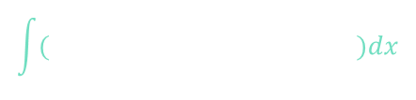


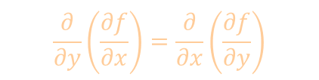


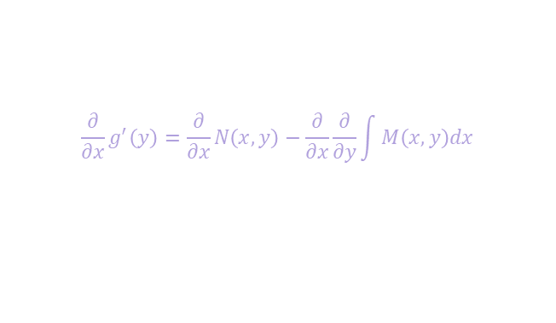

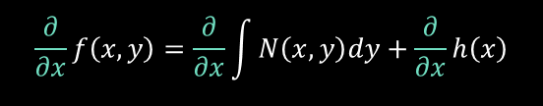



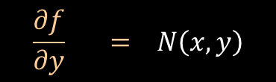
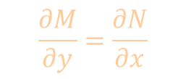

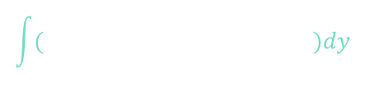












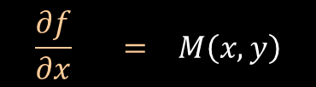

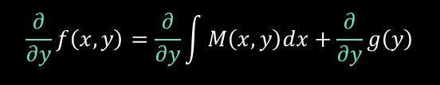





Exact Equations
$$M\left(x, y\right)dx+N\left(x,y\right)dy=0$$
*exact
Criteria for Exactness
$$M\left(x, y\right)=\frac{∂f}{∂x}$$
$$N\left(x,y\right)=\frac{∂f}{∂y}$$
exact
$$\frac{∂M}{∂y}=\frac{∂N}{∂x}$$
$$\frac{∂}{∂y}\left(\frac{∂f}{∂x}\right)=\frac{∂}{∂x}\left(\frac{∂f}{∂y}\right)$$
$$\frac{∂^{2}f}{∂y∂x}=\frac{∂^{2}f}{∂x∂y}$$
*continuous first partial
derivatives in R in $xy$-plane
Solution
$$f\left(x,y\right)=c$$
$$\frac{∂}{∂x}g^{′}\left(y\right)=\frac{∂}{∂x}N\left(x,y\right)−\frac{∂}{∂x}\frac{∂}{∂y}\int{M\left(x,y\right)dx}$$
$$0$$
$$\frac{∂f}{∂x} = M\left(x, y\right)$$
$$f\left(x,y\right)= \int{M\left(x,y\right)dx}+ g\left(y\right)$$
$$M$$
$$dx$$
$$dx$$
$$\frac{∂}{∂x}$$
$$\frac{∂}{∂x}$$
$$\frac{∂}{∂x}$$
$$\frac{∂}{∂x}g^{′}\left(y\right)=\frac{∂N}{∂x}−\frac{∂}{∂y}\frac{∂}{∂x}\int{M\left(x,y\right)dx}$$
$$=\frac{∂N}{∂x}−\frac{∂M}{∂y}$$
$$=0$$
$$\int{ dy}$$
$$\int{( )dy}$$
$$\frac{∂}{∂y}f\left(x,y\right)=\frac{∂}{∂y}\int{M\left(x,y\right)dx}+\frac{∂}{∂y}g\left(y\right)$$
$$N\left(x,y\right)=\frac{∂}{∂y}\int{M\left(x,y\right)dx}+g^{′}\left(y\right)$$
$$g^{′}\left(y\right) = N\left(x,y\right)−\frac{∂}{∂y}\int{M\left(x,y\right)dx}$$
$$M$$
$$\frac{∂f}{∂y} = N\left(x, y\right)$$
$$f\left(x,y\right)=\int{N\left(x,y\right)dy}+h\left(x\right)$$
$$dy$$
$$dy$$
$$\frac{∂}{∂x}f\left(x,y\right)=\frac{∂}{∂x}\int{N\left(x,y\right)dy}+\frac{∂}{∂x}h\left(x\right)$$
$$M\left(x,y\right)=\frac{∂}{∂x}\int{N\left(x,y\right)dy}+h^{′}\left(x\right)$$
$$\int{ dx}$$
$$\int{( )dx}$$
$$h^{′}\left(x\right) = M\left(x,y\right)−\frac{∂}{∂x}\int{N\left(x,y\right)dy}$$

Slide 3




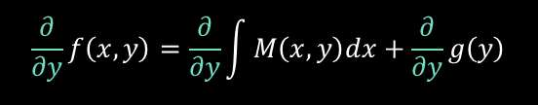
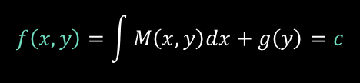

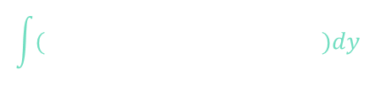









Exact Equations
1. Could it be “Exact”?
$$M\left(x, y\right)dx+N\left(x,y\right)dy=0$$
?
$$f\left(x,y\right)=c$$
Criteria for Exactness
$$M\left(x, y\right)=\frac{∂f}{∂x}$$
$$N\left(x,y\right)=\frac{∂f}{∂y}$$
*continuous first partial
derivatives in R in $xy$-plane
$$\frac{∂M}{∂y}=\frac{∂N}{∂x}$$
$$\frac{∂}{∂y}\left(\frac{∂f}{∂x}\right)=\frac{∂}{∂x}\left(\frac{∂f}{∂y}\right)$$
2. Is it “Exact”?
3. Pick simpler partial, integrate
$$\frac{∂f}{∂x}=M\left(x, y\right)$$
$$f\left(x,y\right)=\int{M\left(x,y\right)dx}+g\left(y\right)$$
$$\frac{∂}{∂y}f\left(x,y\right)=\frac{∂}{∂y}\int{M\left(x,y\right)dx}+\frac{∂}{∂y}g\left(y\right)$$
$$N\left(x,y\right)=\frac{∂}{∂y}\int{M\left(x,y\right)dx}+g^{′}\left(y\right)$$
4. Differentiate other, to get other partial
$$\int{ dy}$$
$$\int{( )dy}$$
$$g^{′}\left(y\right) = N\left(x,y\right)−\frac{∂}{∂y}\int{M\left(x,y\right)dx}$$
5. Isolate integration constant, integrate
$$f\left(x,y\right)=\int{M\left(x,y\right)dx}+g\left(y\right)=c$$
6. Substitute integration constant, simplify
$$M$$
7.* If stuck/messy, repeat process with other partial
$$\frac{∂f}{∂y}=N\left(x, y\right)$$
$$f\left(x,y\right)=c$$
8.* Alternatively, integrate both partials, $f\left(x,y\right)$ will be overlap of solutions
*preferrable when both partials simple

Slide 4


























Example
$$\left(2xy^{2}−3\right)dx+\left(2x^{2}y+4\right)dy=0$$
1. Could it be “Exact”?
$$M\left(x, y\right)dx+N\left(x,y\right)dy=0$$
?
$$f\left(x,y\right)=c$$
$$M\left(x,y\right)$$
$$N\left(x,y\right)$$
$$M\left(x, y\right)=\frac{∂f}{∂x}$$
2. Is it “Exact”?
*continuous first partial
derivatives in R in $xy$-plane
$$\frac{∂M}{∂y}=\frac{∂N}{∂x}$$
$$\frac{∂}{∂y}\left(2xy^{2}−3\right)=\frac{∂}{∂x}\left(2x^{2}y+4\right)$$
$$N\left(x,y\right)=\frac{∂f}{∂y}$$
$$4xy=4xy$$
$$\frac{dy}{dx}=\frac{3−2xy^{2}}{2x^{2}y+4}$$
$$2x^{2}y+4≠0$$
$$y≠−\frac{2}{x^{2}}$$
*singular curve
8.* integrate both partials, $f\left(x,y\right)$ will be overlap of solutions
$$f\left(x,y\right)=\int{M\left(x,y\right)dx}+g\left(y\right)$$
$$f\left(x,y\right)=\int{\left(2xy^{2}−3\right)dx}+g\left(y\right)$$
$$f\left(x,y\right)=x^{2}y^{2}−3x+g\left(y\right)$$
$$h\left(x\right)$$
$$f\left(x,y\right)=\int{N\left(x,y\right)dy}+h\left(x\right)$$
$$f\left(x,y\right)=\int{\left(2x^{2}y+4\right)dy}+h\left(x\right)$$
$$M$$
$$f\left(x,y\right)=x^{2}y^{2}+4y+h\left(x\right)$$
$$g\left(y\right)$$
$$f\left(x,y\right)=x^{2}y^{2}+4y−3x$$
$$x^{2}y^{2}+4y−3x=c$$
$$\frac{∂f}{∂x}=\left(2xy^{2}−3\right)=M$$
$$\frac{∂f}{∂y}=\left(2x^{2}y+4\right)=N$$

Slide 5

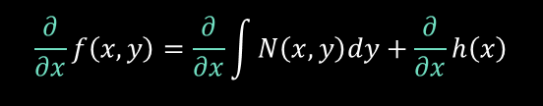





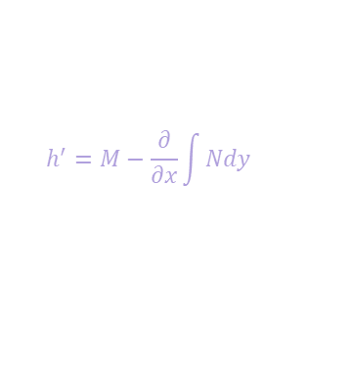




















Example
$$\left(\tan\left(x\right)−\sin\left(x\right)\sin\left(y\right)\right)dx+\left(\cos\left(x\right)\cos\left(y\right)\right)dy=0$$
1. Could it be “Exact”?
$$M\left(x,y\right)$$
$$N\left(x,y\right)$$
$$M\left(x, y\right)dx+N\left(x,y\right)dy=0$$
?
$$f\left(x,y\right)=c$$
3. Pick simpler partial, integrate
2. Is it “Exact”?
$$\frac{∂f}{∂y}=N\left(x, y\right)$$
$$f\left(x,y\right)=\int{N\left(x,y\right)dy}+h\left(x\right)$$
$$M\left(x, y\right)=\frac{∂f}{∂x}$$
$$N\left(x,y\right)=\frac{∂f}{∂y}$$
*continuous first partial
derivatives in R in $xy$-plane
$$\frac{∂M}{∂y}=\frac{∂N}{∂x}$$
$$f\left(x,y\right)=\int{\cos\left(x\right)\cos\left(y\right)dy}+h\left(x\right)$$
$$\frac{∂}{∂y}\left(\tan\left(x\right)−\sin\left(x\right)\sin\left(y\right)\right)=\frac{∂}{∂x}\left(\cos\left(x\right)\cos\left(y\right)\right)$$
$$f\left(x,y\right)=\cos\left(x\right)\sin\left(y\right)+h\left(x\right)$$
$$−\sin\left(x\right)\cos\left(y\right)$$
$$=−\sin\left(x\right)cos⁡(y)$$
4. Differentiate other, to get other partial
$$\frac{∂}{∂x}f\left(x,y\right)=\frac{∂}{∂x}\int{N\left(x,y\right)dy}+\frac{∂}{∂x}h\left(x\right)$$
$$=M\left(x,y\right)$$
$$\cos\left(x\right)\sin\left(y\right)+\ln\left|\sec\left(x\right)\right|=c$$
$$−\sin\left(x\right)\sin\left(y\right)$$
$$h^{′}\left(x\right)$$
$$h^{′}=M−\frac{∂}{∂x}\int{Ndy}$$
5. Isolate integration constant, integrate
$$h^{′}\left(x\right)=\tan\left(x\right)+\sin\left(x\right)\sin\left(y\right)−\sin\left(x\right)\sin\left(y\right)$$
$$\frac{∂f}{∂x}=M\left(x, y\right)$$
$$\frac{∂f}{∂y}=N\left(x, y\right)$$
$$h\left(x\right)=\ln\left|\sec\left(x\right)\right|$$
$$\frac{∂}{∂x}\left(\cos\left(x\right)\sin\left(y\right)+\ln\left|\sec\left(x\right)\right|\right)$$
$$\frac{∂}{∂y}\left(\cos\left(x\right)\sin\left(y\right)+\ln\left|\sec\left(x\right)\right|\right)$$
6. Substitute integration constant, simplify
$$f\left(x,y\right)=\cos\left(x\right)\sin\left(y\right)+\ln\left|\sec\left(x\right)\right|$$
$$−\sin\left(x\right)\sin\left(y\right)+\tan\left(x\right)$$
$$=M\left(x,y\right)$$
$$\cos\left(x\right)\cos\left(y\right)$$
$$=N\left(x,y\right)$$

Slide 6


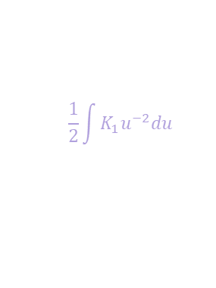

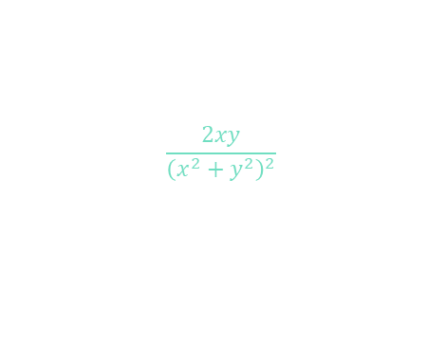
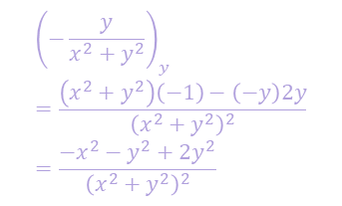








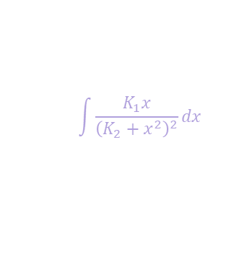


















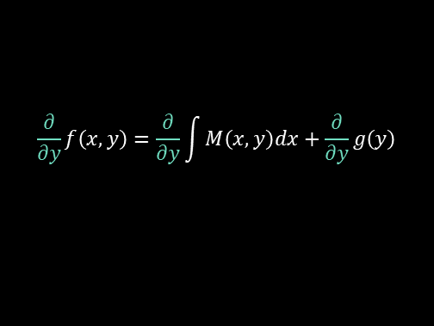
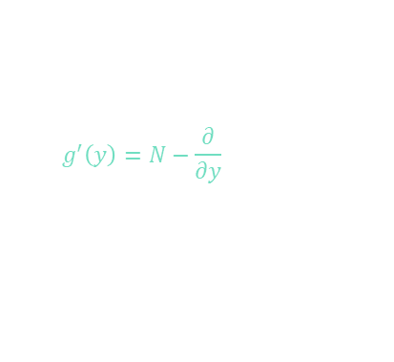




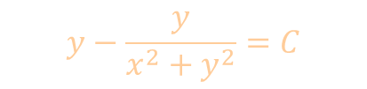







Example
0. Could it be “Exact”?
$$M\left(x, y\right)dx+N\left(x,y\right)dy=0$$
?
$$f\left(x,y\right)=c$$
$$\frac{2xy}{{\left(x^{2}+y^{2}\right)}^{2}} dx+\left[1+\frac{y^{2}−x^{2}}{{\left(x^{2}+y^{2}\right)}^{2}}\right]dy=0$$
1. Is it “Exact”?
$$M\left(x, y\right)=\frac{∂f}{∂x}$$
$$N\left(x,y\right)=\frac{∂f}{∂y}$$
*continuous first partial
derivatives in R in $xy$-plane
$$\frac{∂M}{∂y}=\frac{∂N}{∂x}$$
$$M\left(x,y\right)$$
$$N\left(x,y\right)$$
3. Pick simpler partial, integrate
$$\frac{∂}{∂y}\left(\frac{2xy}{{\left(x^{2}+y^{2}\right)}^{2}}\right)=\frac{∂}{∂x}\left(1+\frac{y^{2}−x^{2}}{{\left(x^{2}+y^{2}\right)}^{2}}\right)$$
$${\left(\frac{hi}{lo}\right)}^{′}=\frac{\left(lo\right){\left(hi\right)}^{′}−\left(hi\right){\left(lo\right)}^{′}}{{\left(lo\right)}^{2}}$$
$$\frac{∂f}{∂x}=M\left(x, y\right)$$
$$f\left(x,y\right)=\int{M\left(x,y\right)dx}+g\left(y\right)$$
$$f\left(x,y\right)=\int{\frac{2xy}{{\left(x^{2}+y^{2}\right)}^{2}}dx}+g\left(y\right)$$
$$\frac{{\left(x^{2}+y^{2}\right)}^{2}2x−\left(2xy\right)2\left(x^{2}+y^{2}\right)2y}{{\left(x^{2}+y^{2}\right)}^{4}}$$
$$=\frac{{\left(x^{2}+y^{2}\right)}^{2}\left(−2x\right)−\left(y^{2}−x^{2}\right)2\left(x^{2}+y^{2}\right)2x}{{\left(x^{2}+y^{2}\right)}^{4}}$$
$${\left(−\frac{y}{x^{2}+y^{2}}\right)}_{y}=\frac{\left(x^{2}+y^{2}\right)\left(−1\right)−\left(−y\right)2y}{{\left(x^{2}+y^{2}\right)}^{2}}=\frac{−x^{2}−y^{2}+2y^{2}}{{\left(x^{2}+y^{2}\right)}^{2}}$$
$$\int{\frac{K_{1}x}{{\left(K_{2}+x^{2}\right)}^{2}}dx}$$
$$u=K_{2}+x^{2}$$
$$\frac{du}{2}=xdx$$
$$\frac{\left(x^{2}+y^{2}\right)2x−8xy^{2}}{{\left(x^{2}+y^{2}\right)}^{3}}$$
$$=\frac{\left(x^{2}+y^{2}\right)\left(−2x\right)−4\left(y^{2}−x^{2}\right)x}{{\left(x^{2}+y^{2}\right)}^{3}}$$
$$du=2xdx$$
$$\frac{1}{2}\int{K_{1}u^{−2}du}$$
$$=−\frac{K_{1}}{2u}$$
$$=−\frac{2y}{2\left(x^{2}+y^{2}\right)}$$
$$\frac{2x^{3}−6xy^{2}}{{\left(x^{2}+y^{2}\right)}^{3}}$$
$$=\frac{2x^{3}−6xy^{2}}{{\left(x^{2}+y^{2}\right)}^{3}}$$
exact
$$f\left(x,y\right)=−\frac{y}{x^{2}+y^{2}}+g\left(y\right)$$
6. Substitute integration constant, simplify
4. Differentiate other, to get other partial
$$\frac{∂f}{∂x}=M\left(x, y\right)$$
$$\frac{∂}{∂x}\left(y−\frac{y}{x^{2}+y^{2}}\right)$$
$$\frac{∂}{∂y}f\left(x,y\right)=\frac{∂}{∂y}\int{M\left(x,y\right)dx}+\frac{∂}{∂y}g\left(y\right)$$
$$f\left(x,y\right)=−\frac{y}{x^{2}+y^{2}}+y$$
$$=N\left(x,y\right)$$
$$=(0)−\frac{\left(x^{2}+y^{2}\right)\left(0\right)−\left(y\right)(2x)}{{\left(x^{2}+y^{2}\right)}^{2}}$$
$$=M\left(x,y\right)$$
$$\frac{y^{2}−x^{2}}{{\left(x^{2}+y^{2}\right)}^{2}}$$
$$g^{′}\left(y\right)$$
$$y−\frac{y}{x^{2}+y^{2}}=C$$
$$\frac{∂f}{∂y}=N\left(x, y\right)$$
$$\frac{∂}{∂y}\left(y−\frac{y}{x^{2}+y^{2}}\right)$$
5. Isolate integration constant, integrate
$$g^{′}\left(y\right)=N−\frac{∂}{∂y}\int{Mdx}$$
$$=1+\frac{y^{2}−x^{2}}{{\left(x^{2}+y^{2}\right)}^{2}}−\frac{y^{2}−x^{2}}{{\left(x^{2}+y^{2}\right)}^{2}}$$
$$g\left(y\right)=y$$
$$=\left(1\right)−\frac{\left(x^{2}+y^{2}\right)\left(1\right)−\left(y\right)\left(2y\right)}{{\left(x^{2}+y^{2}\right)}^{2}}$$
$$=1−\frac{x^{2}−2y^{2}}{{\left(x^{2}+y^{2}\right)}^{2}}$$
$$=N\left(x,y\right)$$

Slide 7
Exact Equations
1. Could it be “Exact”?
$$M\left(x, y\right)dx+N\left(x,y\right)dy=0$$
?
$$f\left(x,y\right)=c$$
Criteria for Exactness
$$M\left(x, y\right)=\frac{∂f}{∂x}$$
$$N\left(x,y\right)=\frac{∂f}{∂y}$$
*continuous first partial
derivatives in R in $xy$-plane
$$\frac{∂M}{∂y}=\frac{∂N}{∂x}$$
$$\frac{∂}{∂y}\left(\frac{∂f}{∂x}\right)=\frac{∂}{∂x}\left(\frac{∂f}{∂y}\right)$$
2. Is it “Exact”?
3. Pick simpler partial, integrate
$$\frac{∂f}{∂x}=M\left(x, y\right)$$
$$f\left(x,y\right)=\int{M\left(x,y\right)dx}+g\left(y\right)$$
$$\frac{∂}{∂y}f\left(x,y\right)=\frac{∂}{∂y}\int{M\left(x,y\right)dx}+\frac{∂}{∂y}g\left(y\right)$$
$$N\left(x,y\right)=\frac{∂}{∂y}\int{M\left(x,y\right)dx}+g^{′}\left(y\right)$$
4. Differentiate other, to get other partial
$$\int{ dy}$$
$$\int{( )dy}$$
$$g^{′}\left(y\right) = N\left(x,y\right)−\frac{∂}{∂y}\int{M\left(x,y\right)dx}$$
5. Isolate integration constant, integrate
$$f\left(x,y\right)=\int{M\left(x,y\right)dx}+g\left(y\right)=c$$
6. Substitute integration constant, simplify
$$M$$
7.* If stuck/messy, repeat process with other partial
$$\frac{∂f}{∂y}=N\left(x, y\right)$$
$$f\left(x,y\right)=c$$
8.* Alternatively, integrate both partials, $f\left(x,y\right)$ will be overlap of solutions
*preferrable when both partials simple

Slide 8

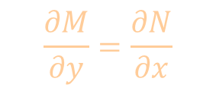
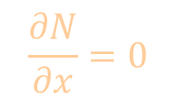
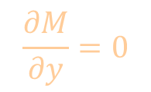

Separable Variables Exact …?
$$M\left(x, y\right)dx+N\left(x,y\right)dy=0$$
$$M\left(x\right)dx+N\left(y\right)dy=0$$
$$\frac{∂M}{∂y}=0$$
$$\frac{∂N}{∂x}=0$$
$$M$$
$$\frac{∂M}{∂y}=\frac{∂N}{∂x}$$

Slide 9











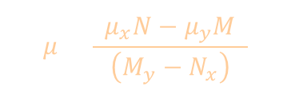






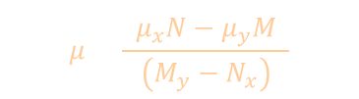








Non-exact
Non-exact
$$M\left(x, y\right)dx+N\left(x,y\right)dy=0$$
$$f\left(x,y\right)=c$$
Criteria for Exactness
$$M\left(x, y\right)=\frac{∂f}{∂x}$$
$$N\left(x,y\right)=\frac{∂f}{∂y}$$
$$\frac{∂M}{∂y}=\frac{∂N}{∂x}$$
$$\frac{∂}{∂y}\left(\frac{∂f}{∂x}\right)=\frac{∂}{∂x}\left(\frac{∂f}{∂y}\right)$$
?
?
*continuous first partial
derivatives in R in $xy$-plane
make Exact
Criteria for Exactness
$$\frac{∂}{∂x}(μM)=\frac{∂}{∂x}\left(μN\right)$$
$$μ\frac{∂M}{∂y}+\frac{∂μ}{∂y}M=μ\frac{∂N}{∂x}+\frac{∂μ}{∂x}N$$
$$μ\left(x,y\right) M\left(x, y\right)dx+μ\left(x,y\right)N\left(x,y\right)dy=0$$
$$μM=\frac{∂f}{∂x}$$
$$μN=\frac{∂f}{∂y}$$
$$μM_{y}+μ_{y}M=μN_{x}+μ_{x}N$$
$$μ=\frac{\left(μ_{x}N−μ_{y}M\right)}{\left(M_{y}−N_{x}\right)}$$
*assuming in terms of x & y
gives PDE
$$0$$
*in terms of x
$$μ=\frac{\left(μ_{x}N−μ_{y}M\right)}{\left(M_{y}−N_{x}\right)}$$
$$μ=\frac{μ_{x}N}{\left(M_{y}−N_{x}\right)}$$
$$\frac{dμ}{μ}=\frac{\left(M_{y}−N_{x}\right)}{N}dx$$
$$μ\left(x\right)=e^{\int{\frac{\left(M_{y}−N_{x}\right)}{N}dx}}$$
$$\frac{\left(M_{y}−N_{x}\right)}{N}$$
$$μ\left(x\right)=e^{\int{\frac{\left(M_{y}−N_{x}\right)}{N}dx}}$$
*in terms of x
*in terms of x
$$0$$
*in terms of y
$$μ=\frac{\left(μ_{x}N−μ_{y}M\right)}{\left(M_{y}−N_{x}\right)}$$
$$μ=\frac{−μ_{y}M}{\left(M_{y}−N_{x}\right)}$$
$$\frac{dμ}{μ}=\frac{\left(N_{x}−M_{y}\right)}{M}dy$$
$$μ\left(y\right)=e^{\int{\frac{\left(N_{x}−M_{y}\right)}{N}dy}}$$
$$\frac{\left(N_{x}−M_{y}\right)}{M}$$
$$μ\left(y\right)=e^{\int{\frac{\left(N_{x}−M_{y}\right)}{M}dy}}$$
*in terms of y
*in terms of y

Slide 10













Non-Exact Made Exact
Criteria for Exactness Fails
1. Not “Exact”
$$M\left(x, y\right)dx+N\left(x,y\right)dy=0$$
$$f\left(x,y\right)=c$$
$$\frac{∂M}{∂y}=\frac{∂N}{∂x}$$
$$\frac{∂}{∂y}\left(\frac{∂f}{∂x}\right)=\frac{∂}{∂x}\left(\frac{∂f}{∂y}\right)$$
*continuous first partial
derivatives in R in $xy$-plane
$$\frac{\left(M_{y}−N_{x}\right)}{N}$$
$$μ\left(x\right)=e^{\int{\frac{\left(M_{y}−N_{x}\right)}{N}dx}}$$
2. Check if integrating factor (of $x$) makes exact “Exact”?
*in terms of x
$$\frac{\left(N_{x}−M_{y}\right)}{M}$$
$$μ\left(y\right)=e^{\int{\frac{\left(N_{x}−M_{y}\right)}{M}dy}}$$
3.* If not, check if integrating factor (of $y$) makes exact “Exact”?
*in terms of y
$$μM\left(x, y\right)dx+μN\left(x,y\right)dy=0$$
$$f\left(x,y\right)=c$$
4. Substitute integrating factor
$$M$$
$$N$$
5. Execute procedure for “Exact”
(earlier in video)
$$M$$

Slide 11

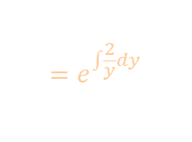
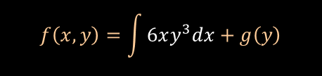











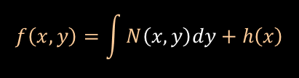



















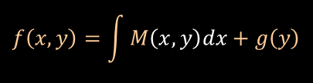


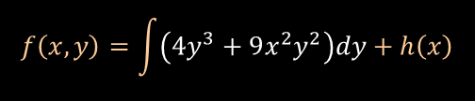
Example
0. Could it be “Exact”?
$$M\left(x, y\right)dx+N\left(x,y\right)dy=0$$
?
$$f\left(x,y\right)=c$$
$$6xy dx+\left(4y+9x^{2}\right)dy=0$$
$$M\left(x, y\right)=\frac{∂f}{∂x}$$
$$M\left(x,y\right)$$
$$N\left(x,y\right)$$
1. Is it “Exact”?
*continuous first partial
derivatives in R in $xy$-plane
$$\frac{∂M}{∂y}=\frac{∂N}{∂x}$$
$$N\left(x,y\right)=\frac{∂f}{∂y}$$
$$\frac{∂}{∂y}6xy=\frac{∂}{∂x}\left(4y+9x^{2}\right)$$
$$6xy^{3} dx+\left(4y^{3}+9x^{2}y^{2}\right)dy=0$$
$$6x=18x$$
Not Exact
$$M\left(x,y\right)$$
$$N\left(x,y\right)$$
$$\frac{∂M}{∂y}=\frac{∂N}{∂x}$$
$$\frac{∂}{∂y}\left(6xy^{3}\right)=\frac{∂}{∂x}\left(4y^{3}+9x^{2}y^{2}\right)$$
2. Check if integrating factor (of $x$) makes exact “Exact”?
$$\frac{\left(M_{y}−N_{x}\right)}{N}$$
$$=\frac{\left(6x\right)−\left(18x\right)}{4y+9x^{2}}$$
$$=\frac{−12x}{4y+9x^{2}}$$
$$18xy^{2}=0+18xy^{2}$$
Not of $x$
Made Exact
3.* If not, check if integrating factor (of $y$) makes exact “Exact”?
* integrate both partials, $f\left(x,y\right)$ will be overlap of solutions
$$\frac{\left(N_{x}−M_{y}\right)}{M}$$
$$=\frac{\left(18x\right)−\left(6x\right)}{6xy}$$
$$f\left(x,y\right)=\int{M\left(x,y\right)dx}+g\left(y\right)$$
$$f\left(x,y\right)=\int{6xy^{3}dx}+g\left(y\right)$$
$$=\frac{12x}{6xy}$$
$$=\frac{2}{y}$$
$$f\left(x,y\right)=3x^{2}y^{3}+g\left(y\right)$$
of $y$
$$f\left(x,y\right)=\int{N\left(x,y\right)dy}+h\left(x\right)$$
$$f\left(x,y\right)=\int{\left(4y^{3}+9x^{2}y^{2}\right)dy}+h\left(x\right)$$
$$μ\left(y\right)=e^{\int{\frac{\left(N_{x}−M_{y}\right)}{M}dy}}$$
$$=e^{\int{\frac{2}{y}dy}}$$
$$=e^{2\ln\left|y\right|+C}$$
$$=Cy^{2}$$
$$0$$
4. Substitute integrating factor
$$f\left(x,y\right)=y^{4}+3x^{2}y^{3}+h\left(x\right)$$
$$μ6xy dx+μ\left(4y+9x^{2}\right)dy=0$$
$$g\left(y\right)$$
$$y^{4}+3x^{2}y^{3}=c$$
$$f\left(x,y\right)=y^{4}+3x^{2}y^{3}$$
$$Cy^{2}6xy dx+Cy^{2}\left(4y+9x^{2}\right)dy=0$$

Slide 12





Example
$$6xy dx+\left(4y+9x^{2}\right)dy=0$$
$$y^{4}+3x^{2}y^{3}=c$$
$$\frac{dy}{dx}=\frac{−6xy}{4y+9x^{2}}$$
$$4y+9x^{2}≠0$$
$$y≠\frac{−9x^{2}}{4}$$
*singular curve
$$M$$
$$x^{2}y^{2}+4y−3x=c$$

